Slide 1




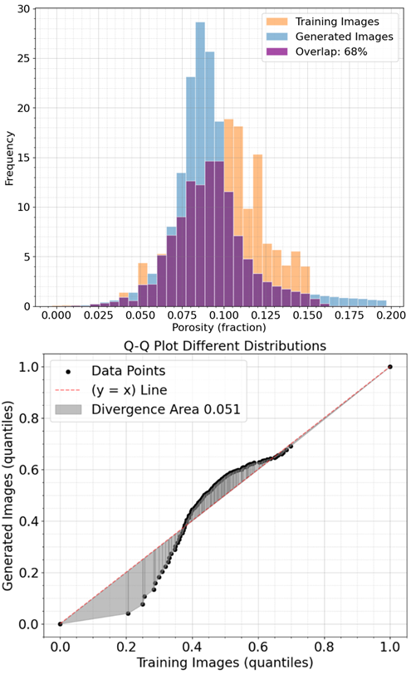
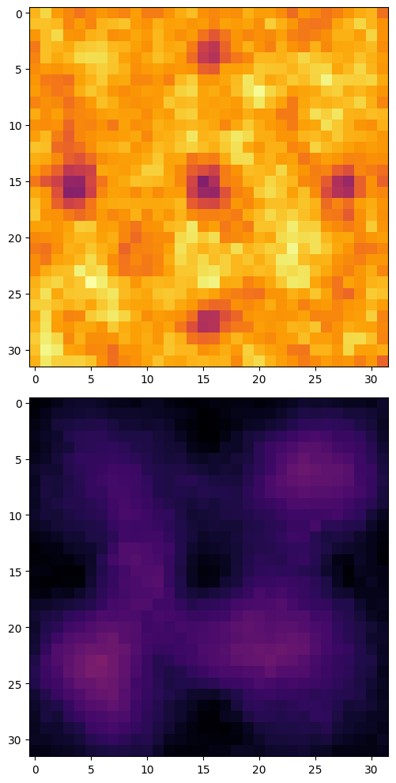
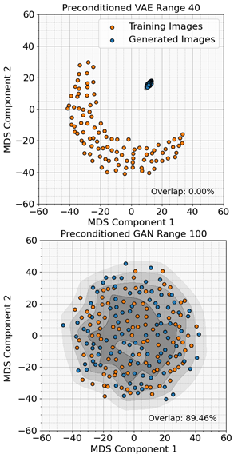
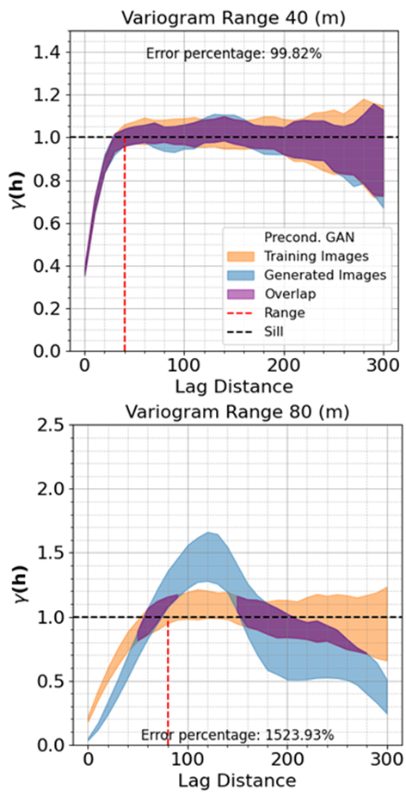
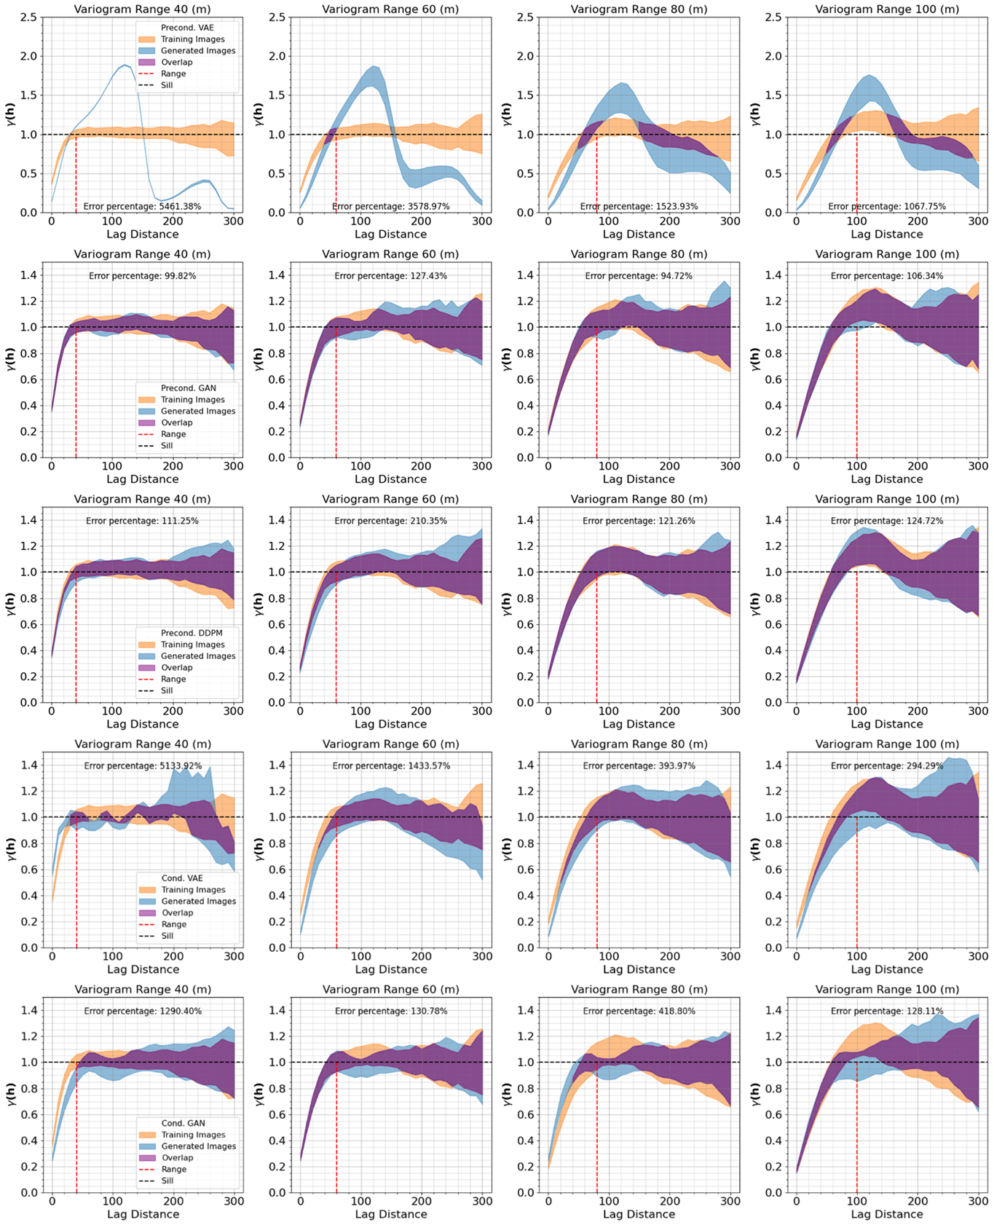
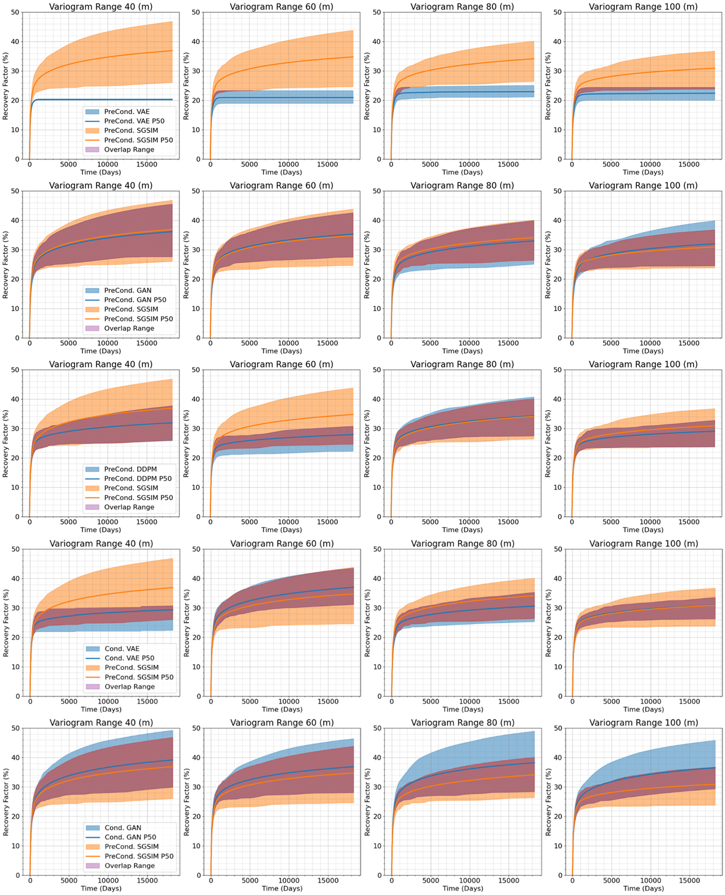
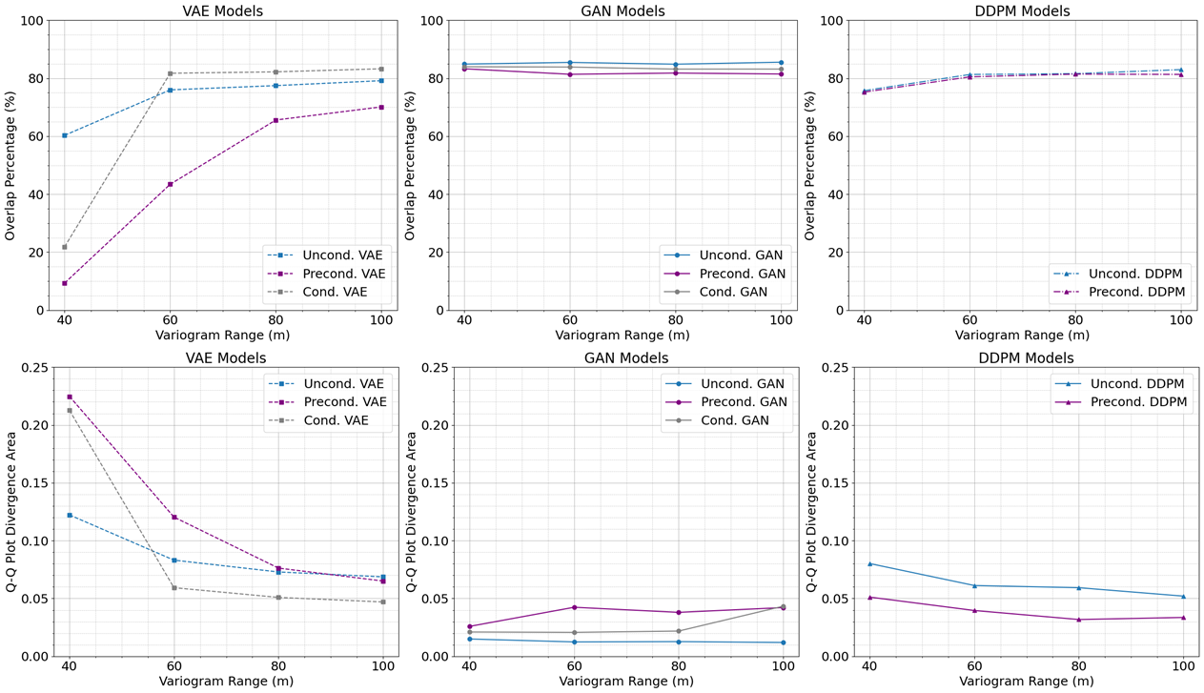
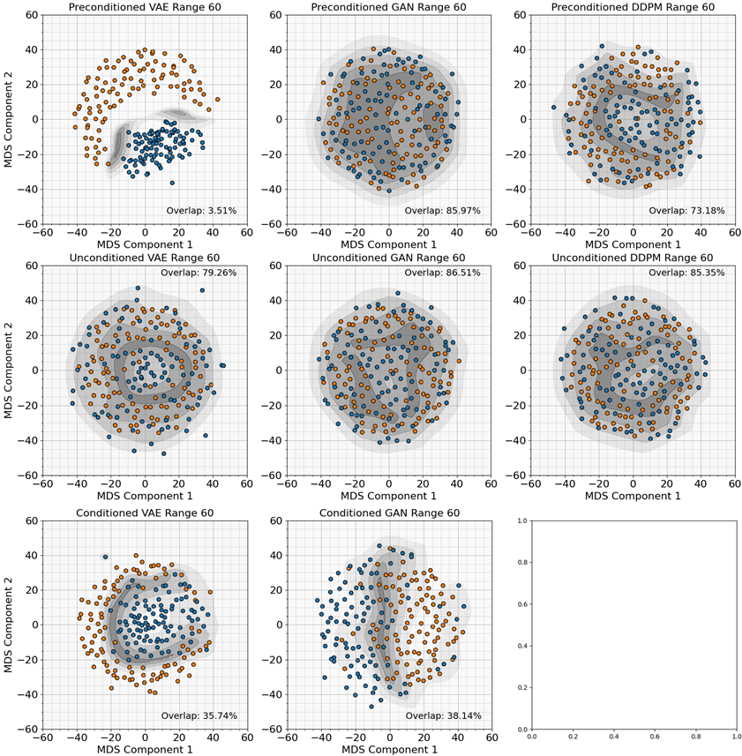
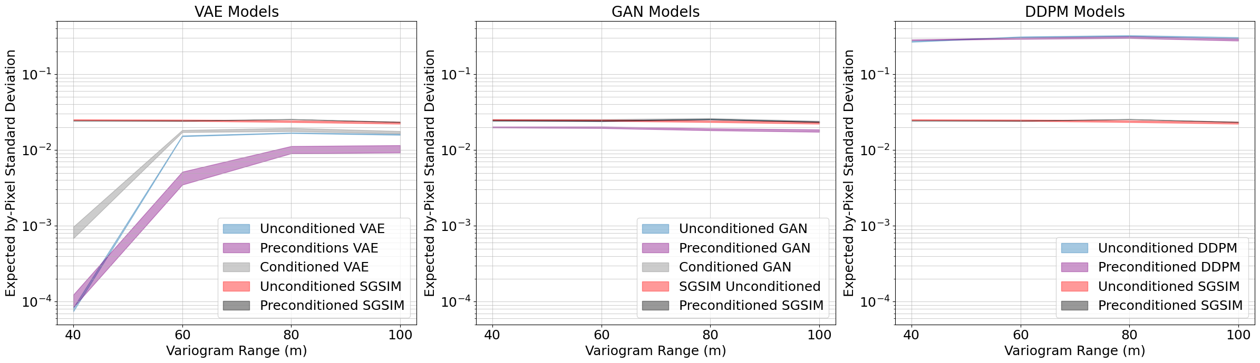
Static and Dynamic Model Checking of Generative Artificial Intelligence Models for Subsurface Modeling
Ahmed Merzoug, Lei Liu, Michael Pyrcz
The University of Texas at Austin
Introduction & problem statement
Business value (why is this important?
Generative AI enhances reservoir modeling capabilities, offering geological authenticity akin to rule-based geostatistical and physics-driven models, along with the comprehensive data conditioning associated with pixel-based geostatistical models. Yet, the prevalent method of evaluating these models through visual inspection is not adequate. Given the crucial role of these models in supporting high-stake subsurface development decisions, adopting quantitative statistical measures for rigorous model validation is essential, but not yet a widespread practice.
We applied novel static and dynamic model checking on variational autoencoders (VAE), generative adversarial networks (GANs), and denoising diffusion probabilistic (DDPM) models for creating subsurface models, applying both static and dynamic evaluation metrics.
The use of generative AI models in subsurface modeling without sufficient model checking for decision-making and uncertainty analysis can lead to misleading outcomes, potentially resulting in poor investment choices. The application of our proposed model checks will greatly improve the reliability of genAI for subsurface modeling
methodology
Models training
Uncond. VAE
Cond. VAE
Static Checks
Dynamic Check
Uncond. SGSIM
Uncond. GAN
Cond. GAN
Global Univariate Distribution
Local Uncertainty Model
Global Uncertainty Model
Global Spatial Continuity
Sequential gaussian simulation (SGSIM) is used to generate unconditioned (uncond.) and preconditioned (precond.) training images. The precond. are 5 spot wells pattern. All these images are used for training genAI models.
Uncond. DDPM
After training all models, unconditioned GANs and VAEs are conditioned (cond.) by optimizing the latent space to match the 5 spot pattern. The checks compare genAI uncond. models to uncond. SGSIM. The genAI precond. and the cond. models to precond. SGSIM.
Precond. VAE
One water injector and four producers. The models results are compared based on the recovery factor. Results from cond., and precond. genAI are compared to precond. SGSIM.
Precond. SGSIM
Precond. GAN
Precond. DDPM
RESULTS & DISCUSSION
Conclusion, recommendations & future work
1) Results show that VAEs are sensitive to changes in the variogram range, whereas GANs and DDPM are not.
2) Comparing the expected value of by-pixel standard deviations to SGSIM, VAEs suffer from model collapse and exhibit the lowest variety. GANs' performance is very close to SGSIM. DDPM displays more variety and uncertainty compared to SGSIM.
3) Low-dimensional comparison of the similarity and the variety of images in MDS space shows that uncond. and precond. GANs, followed by DDPM, outperform VAEs in terms of image similarity and variety.
4) Cond. VAEs show more similarity to precond. SGSIM with low variety. Cond. GANs have less similarity but more variability.
5) Variogram reproduction is good for uncond., cond., and precond. GANs and DDPM are decent for cond. VAEs. Precond. VAEs are unable to reproduce the spatial continuity.
6) Precond. VAEs' flow simulations suffer from model collapse with no recovery factor reproduction. Precond. GANs have very good performance. Precond. DDPM performance is intermediate. Cond. VAEs had better recovery factor reproduction than cond. GANs, which exhibit more uncertainty.
We propose a novel set of model checks tailored to genAI subsurface models prior to the application to support decision-making
Our novel model checks show that GANS consistently outperform other genAI models
We plan to incorporate some of the evaluation checks to loss function during training to improve model output.
Precond. VAE
Precond. GAN
Good reproduction
Precond. DDPM
Low reproduction
SGSIM
Cond. VAE
No reproduction
GenAI
Overlap
Acknowledgments The authors thank the Digital Rock Characterization Technology (DIRECT) Industry Affiliate Program at the University of Texas at Austin for supporting this work.
Cond. GAN

